Slide 1
HOTEL BOOKING
CANCELLATION
Sungjun Lee & Tim Kim

Slide 2
Will a customer cancel the hotel booking ?
Question

Slide 3
Table of contentS
01
02
Exploratory data analysis
Data preprocessing
03
04
Classification models
results

Slide 4
01
Exploratory data analysis

Slide 5





Frameworks & Libraries
Python
sklearn
pandas
seaborn
maplotlib

Slide 6
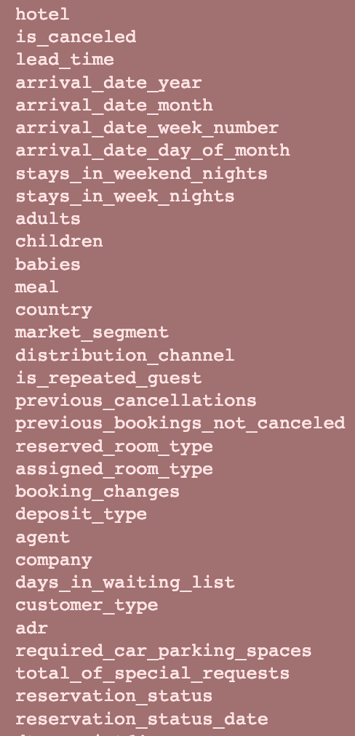
dataset
~119,000 Hotel Bookings Dataset Includes key interesting features
Guest / Previous User
Adults / Children / Babies
Arrival Time
Special Requests
Room Type

Slide 7
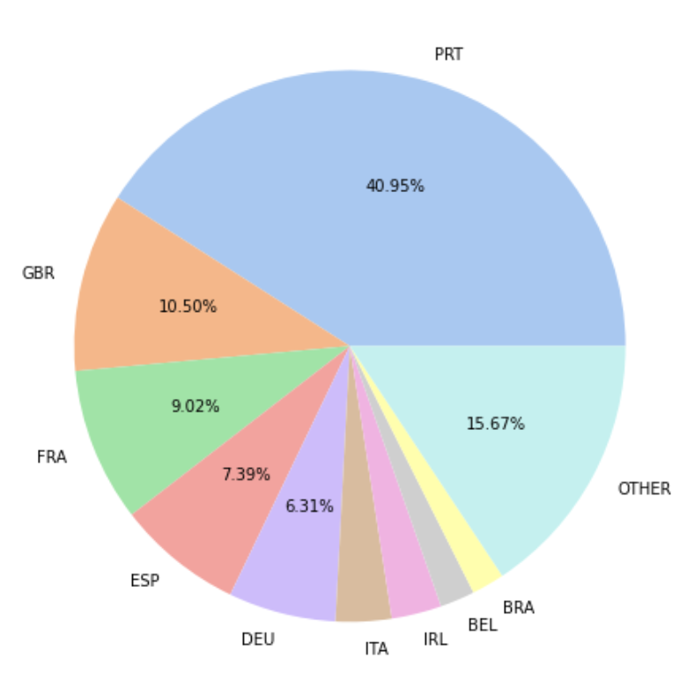
EDA
Which country saw the most booking according to the data?
PRT at 40.95%

Slide 8
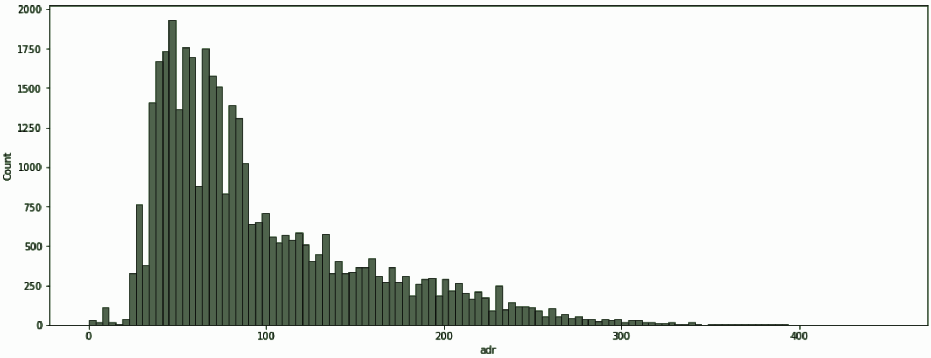
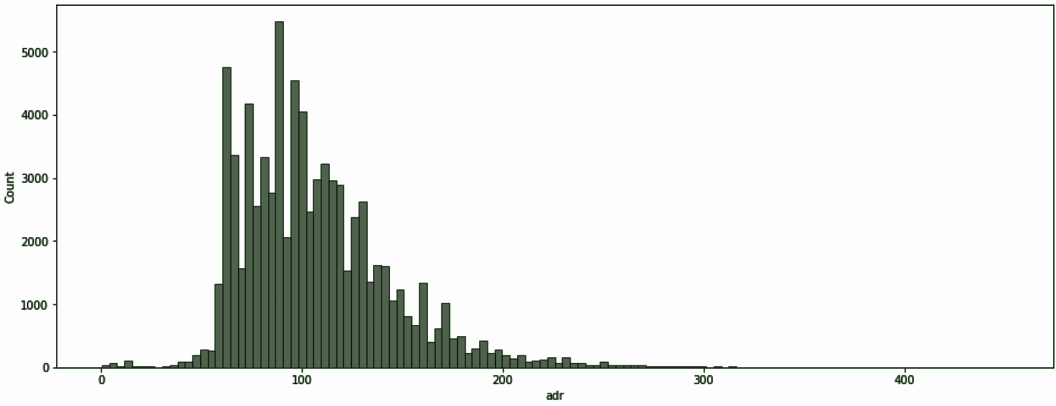
EDA
What is the distribution like for both hotels with respect to price of a room per night?
Both Hotels are skewed to the left
Resort Hotel ADR Distribution
II. City Hotel ADR Distribution

Slide 9
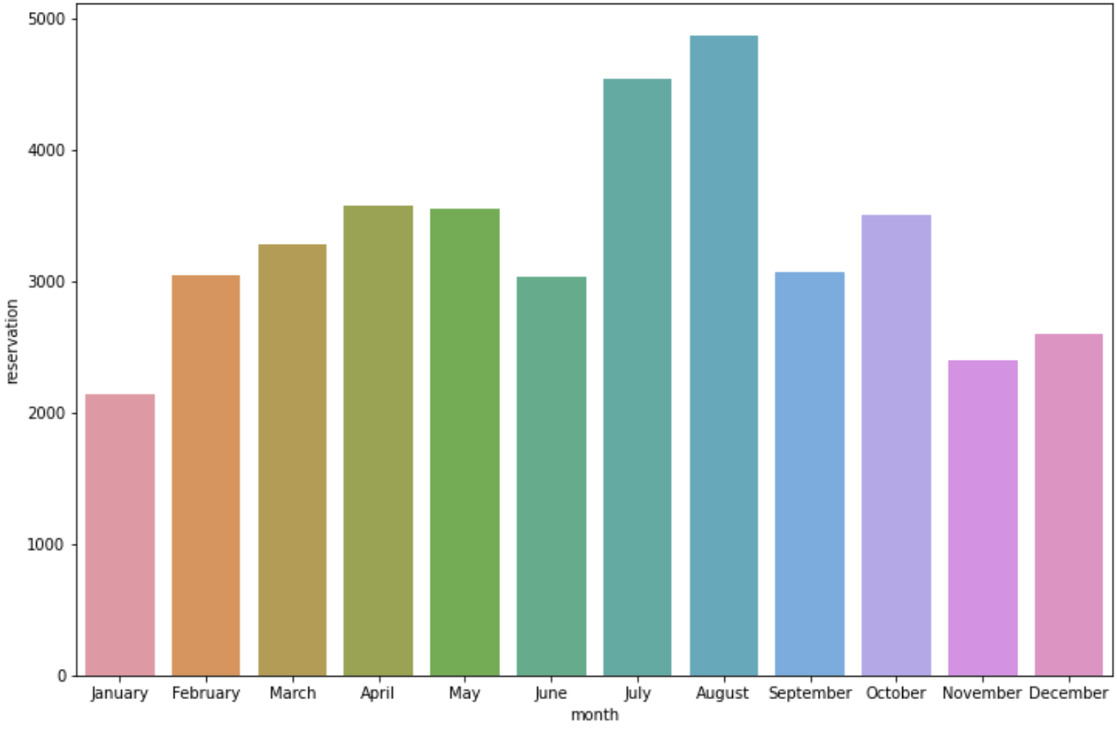
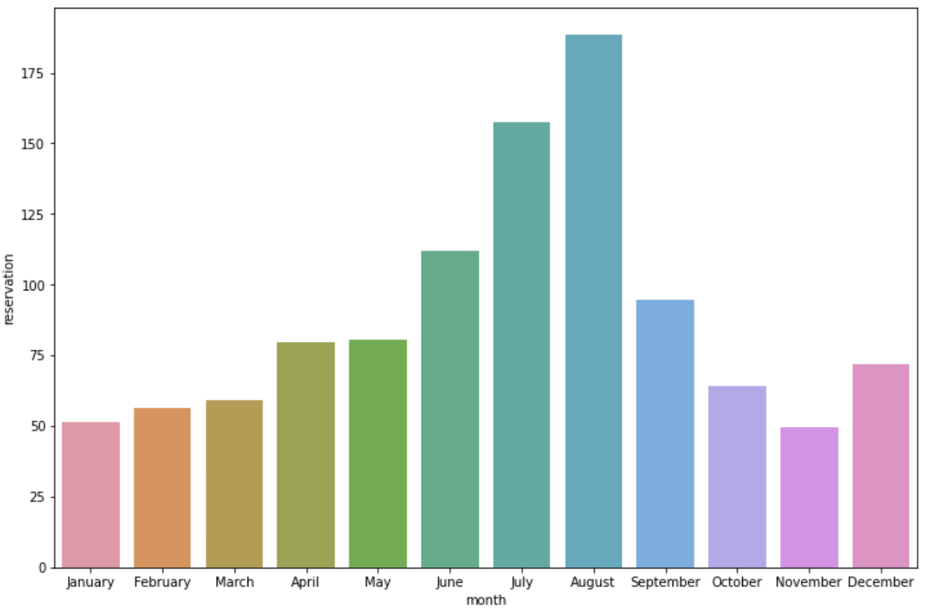
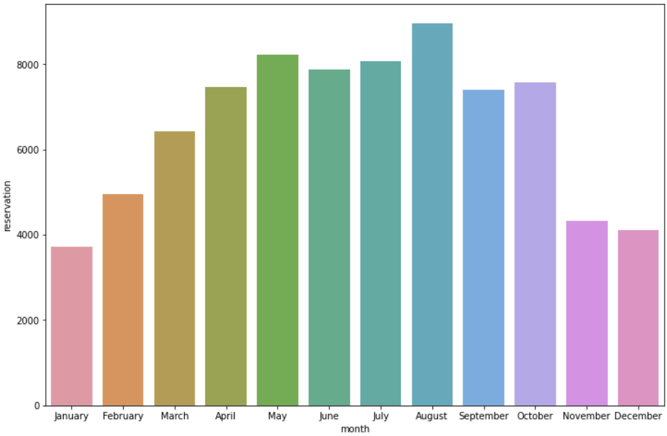
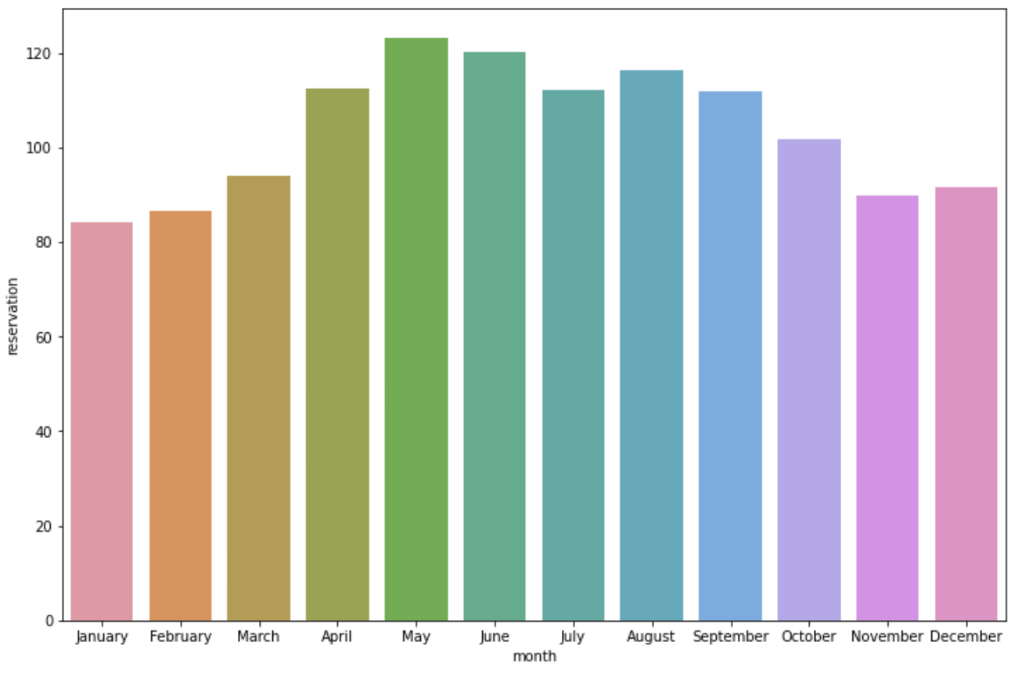
EDA
Which months are the most busy for both hotels? Which months see the most expensive per night cost?
Both Hotels are most busy during August & most expensive during August / May
Resort Hotel Busiest / Expensive
II. City Hotel Busiest / Expensive

Slide 10
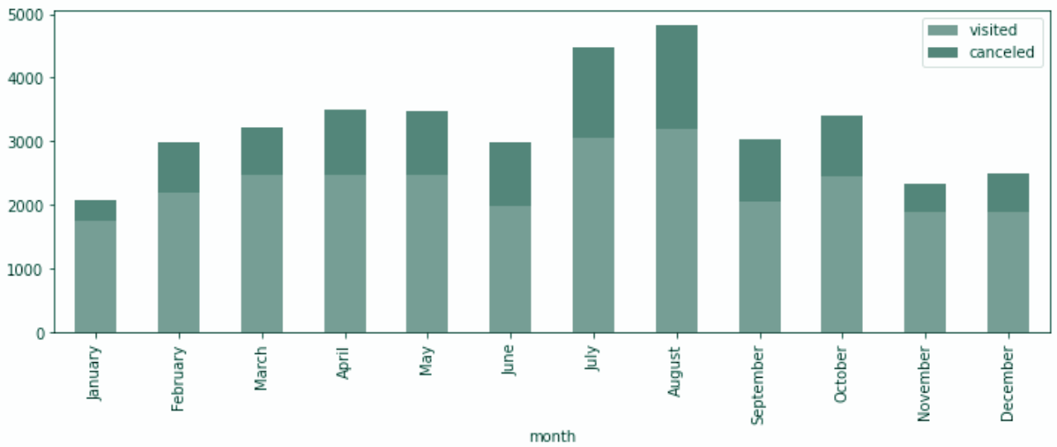
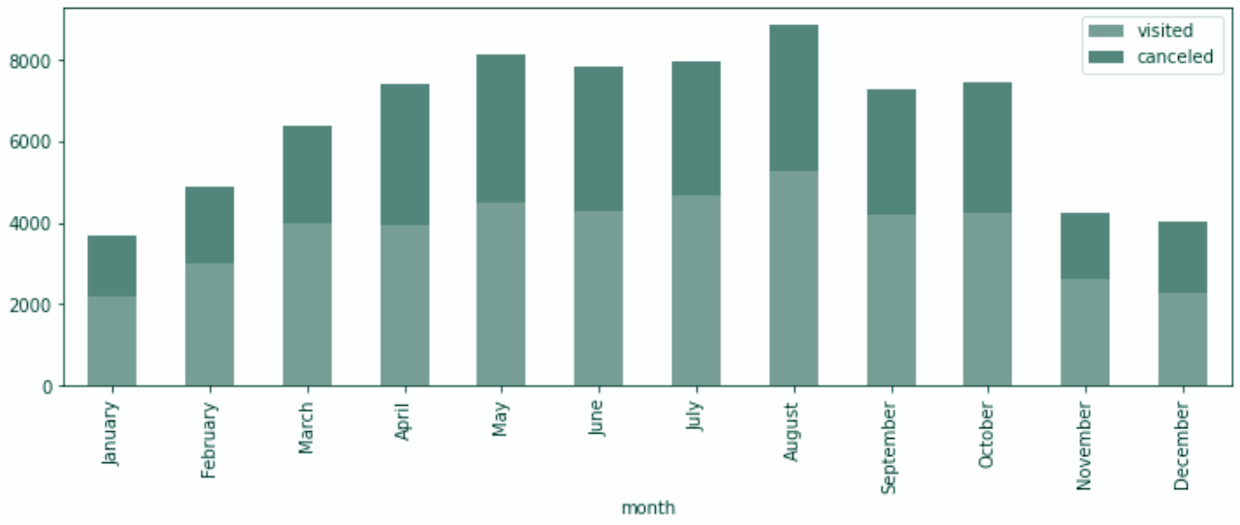
EDA
Which months see the most cancellations for both hotels?
Resort Hotels have the most cancellation rate in August
City Hotels have the most cancellation rate in April
(Not a significant difference)
Resort Hotel
II. City Hotel:

Slide 11
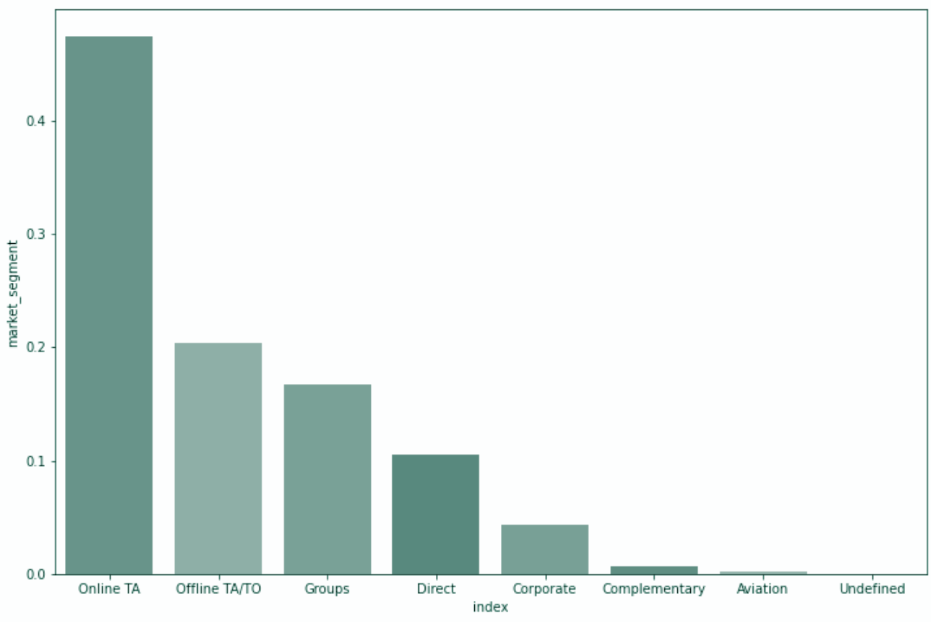
EDA
Examine distributions of bookings vs. market segment
Online TA Market Segment takes up the most of the bookings
Bookings vs. Market Segment

Slide 12
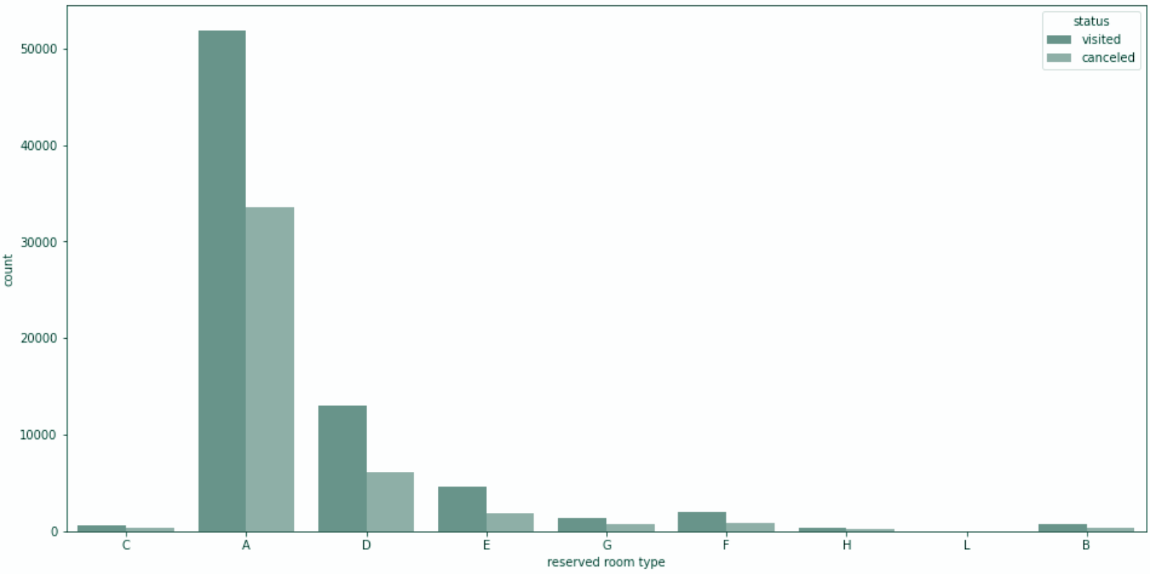
EDA
Which room type was the most commonly booked and most commonly cancelled?
Room Type A was the most booked and cancelled.
Booked vs. Cancelled

Slide 13
02
DATA PREPROCESSING

Slide 14
DATA PREPROCESSING
Observed 119390 raw row data with 32 features
Found 4 missing data for children, 488 for country, 16,340 for agent, and 112,593 for company
Children
Majority of the data is already 0, and only 4 are missing
Replaced missing data with 0
Country
Only 488 are missing, which is small
Dropped 488 rows of data
Agent & Company
Put Missing Value as “0”, which we define as unknown column
Replaced NA with 0
Others
Meal: Undefined as “SC”
Dropped rows with 0 or negative ADR
Dropped rows with 0 adults, 0 children, 0 baby

Slide 15
03
CLassification models

Slide 16
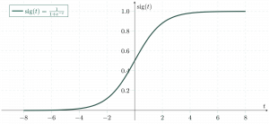
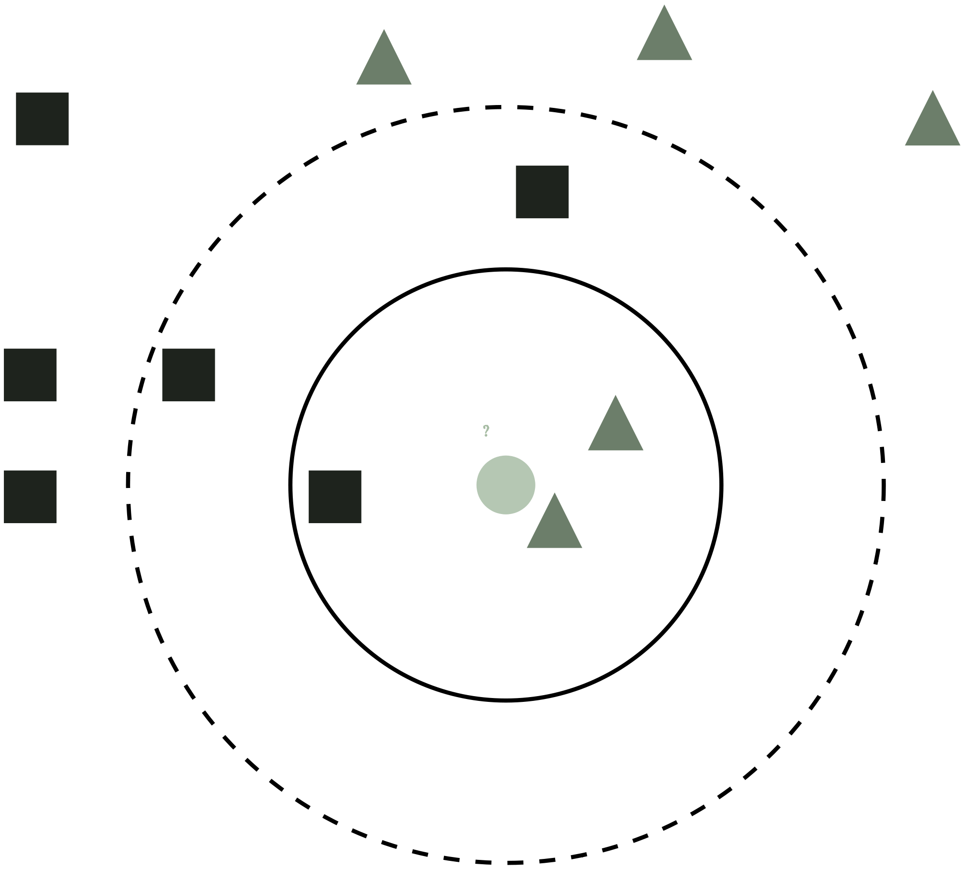
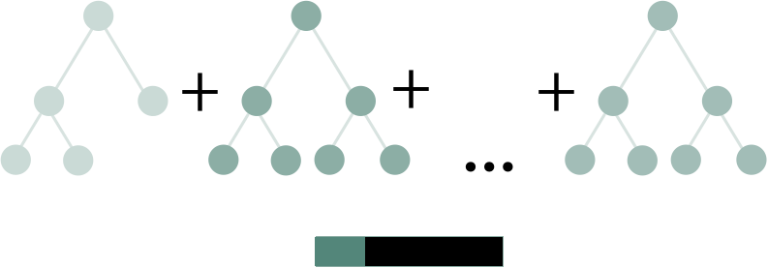
CLASSIFICATION MODELS
LOGISTIC REGRESSION
K-Nearest Neighbour
CATBOOST
Predicts binary classification using logistic regression
Estimates the likelihood of data to a group based on nearest points
Gradient boosting on decision tree

Slide 17
TRAINING / TESTING
Data pipeline
TRAINING
TESTING
CROSS VALIDATION
70% of data
30% of data
KFOLDS = 5

Slide 18
04
RESULTS

Slide 19
Weighted F1 Score results
69%
88%
97%
Logistic Regression
KNN
Catboost

Slide 20
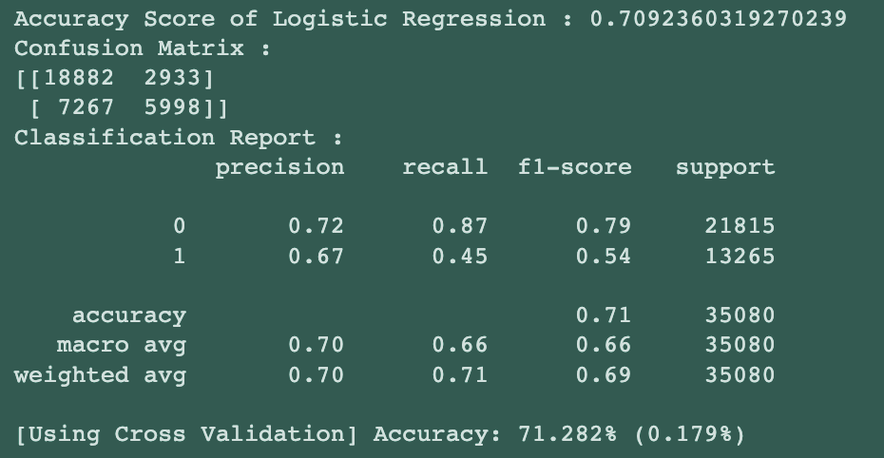
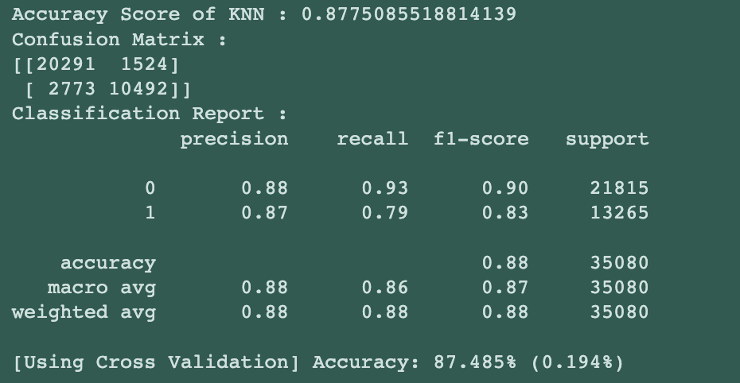
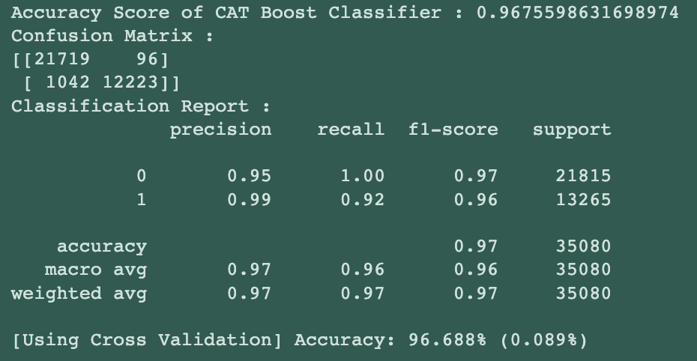
DETAILED RESULTS
LOGISTIC REG.
KNN
cATBOOST

Slide 21
DIFF. WITH/Without CROSS VALIDATION
+0.28%
-0.51%
-.312%
Logistic Regression
KNN
Catboost

Slide 22
Thanks!
Do you have any questions?
sungjun.lee@stonybrook.edu
daekyung.kim@stonybrook.edu

